Slide 1
PSYC 2012: Biological Psychology I
Week 10: The Chemical Senses and the Sensorimotor System

Slide 2
Goals of This Week’s Lectures:
To determine how our nervous system produces voluntary movement and to define cognition and learn how it is studied

Slide 3
The Chemical Senses
Taste and Smell

Slide 4
Gustation
Taste

Slide 5
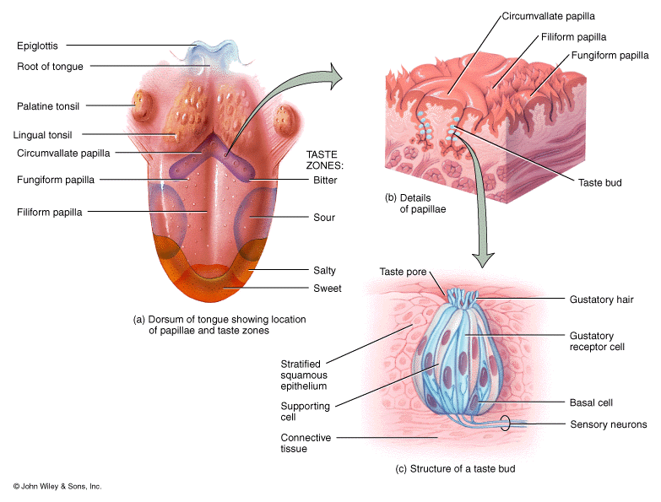
Anatomy of Gustation
Chemicals enter the mouth and are dissolved in saliva
Chemicals dissolved in saliva access taste receptors located in taste buds found primarily on the tongue
The mouth also has receptors for touch and temperature

Slide 6
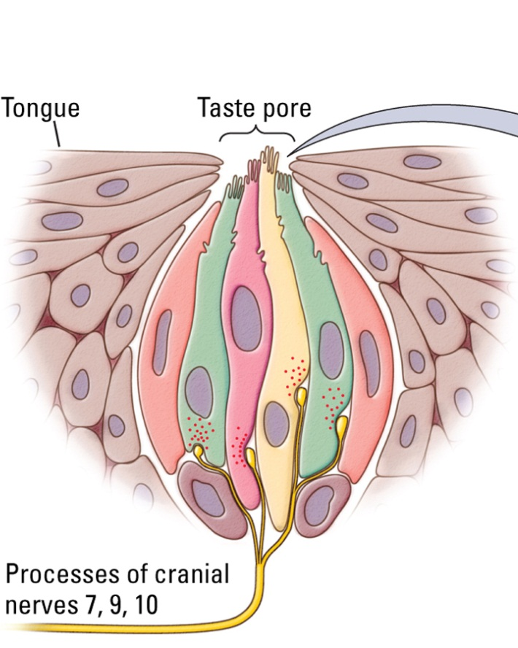
Neurophysiology of Gustation
Chemicals bind to receptors or enter a channel on taste bud receptor cells
Binding to receptors or movement through channel opens Na+ channels or closes K+ channels
Opening of Na+ channels or closing of K+ channels depolarizes receptor cells
Depolarization results in release of neurotransmitter onto sensory neurons
NT release induces action potentials on sensory neurons

Slide 7
What are the 5 Different Tastes?
Sweet-surface receptors bind to glucose and similar sugars and opens a Na+ channel
Salty-ion channel lets Na+ enter cell
Sour-on channels lets H+ ions into cell, which closes a K+ channel
Bitter- binds to a wide range of aromatic compounds, which opens a Na+ channel
Umami- “savory”—binds to the amino acid glutamate, which opens a Na+ channel
(Fat—may bind to fatty acids)

Slide 8
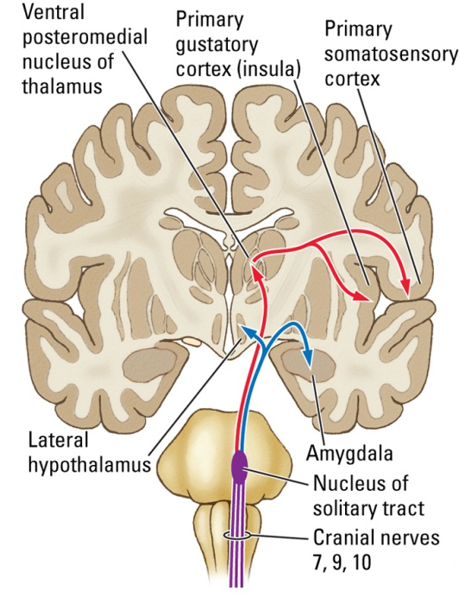
Pathways to Gustatory Cortex
Neurons from taste buds send axons to neurons in the brainstem, which send axons to the thalamus which then project to the primary gustatory (taste) cortex, the insular cortex
Information about “mouth feel”, temperature, spiciness, etc., is sent to the primary somatosensory cortex
Brainstem neurons also send axons directly to the amygdala and hypothalamus that provide direct emotional and eating behavior input

Slide 9
What Are Some Factors Influencing Taste?
Emotional state–when we’re sad or anxious, food tastes less good—comfort foods—input from amygdala
Past experience – foods that have sickened us taste less good, new/strange foods taste less good than familiar ones—input from hippocampus
Hunger—when we are hungry things taste better—input from lateral hypothalamus
Other sensory inputs – flavor is the multisensory integration of taste, smell, “mouth feel”, color, and other sensory inputs and is processed in the orbitofrontal cortex, which also integrates flavor with reward pathways.

Slide 10

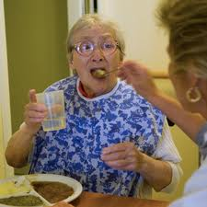
Ageusia—Loss of Sense of Taste
Causes—genetics, some medications, vitamin deficiencies (B3, zinc), endocrine disease, neurodegenerative diseases, damage to lingual nerve (oral surgery) or taste buds (smoking, chemotherapy), strokes, tumors, TBI, infections, toxins that affect the cortical taste center
Outcomes—can lead to decreased appetite and eating, increased risk of consuming something toxic, depression

Slide 11
Olfaction
Smell

Slide 12
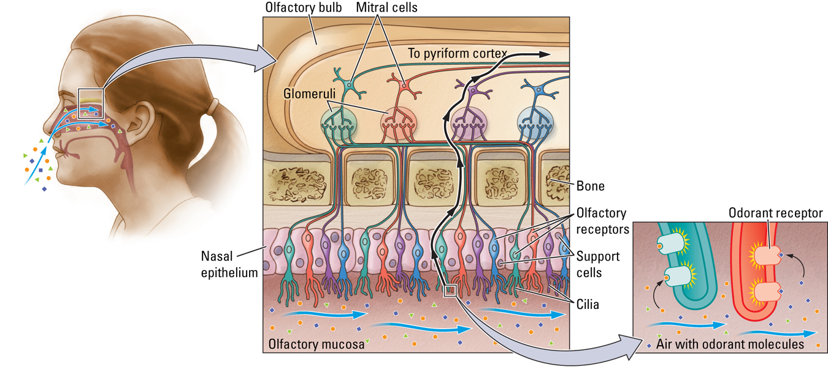
Neurophysiology of the Olfactory System
Chemical odorants enter the nasal cavity and dissolve in the olfactory mucosa
Odorants bind to receptors on the surface of olfactory receptor cells
Odorant binding causes opening of Ca2+ channels and depolarization, which produces action potentials on sensory neurons
There are about 400 different types of olfactory receptors found on different types of olfactory receptor neurons in the human nose that respond to different smells

Slide 13
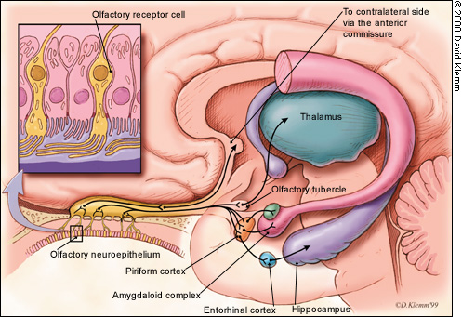
Pathways to the Olfactory Cortex
Olfactory receptor cells send axons to the olfactory bulb and synapse on mitral cells
Mitral cells send axons directly to the primary olfactory center, the piriform cortex—smell is the only sense that bypasses the thalamus
Olfactory information is also sent to several areas of the brain, including the amygdala, hippocampus, and hypothalamus, involved in emotional behaviors, memory, and eating—like taste, smell has strong and rapid effects on memory and emotion

Slide 14
What Are Some Behavioral Aspects of Olfaction-What is Smell Important For?
Eating behaviors—good or bad smelling food may encourage or discourage us from eating –80% of flavor comes from the nose
Danger – fire or predator scent
Sex and social behaviors—scent of receptive females, self, kin, strangers of our own species.

Slide 15



Human Smell & Behavior
Nearly all reactions to smell are learned—babies show no difference in reaction to good vs. bad smells, there are no universally recognized smells across cultures
Mothers can identify blood offspring but not stepchildren, and siblings can identify blood siblings but not half- or step-siblings—may be responsible for the Westermarck Effect
Women tend to find the smell of men who are genetically different from them more pleasant, which may be a mechanism by which genetic variation is increased during mate selection

Slide 16

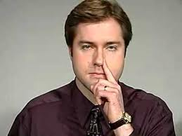
Anosmia—Loss of Sense of Smell
Causes—genetics, some medications, infections, nasal trauma, neurodegenerative diseases (Parkinson’s & Alzheimer’s), nasal polyps, strokes, tumors, TBI, infections affecting the cortical smell centers
Outcomes—decreased appetite and eating, danger from gas or smoke or other threatening smells, depression, loss of libido

Slide 17
Movement is a major characteristic of animals

Slide 18
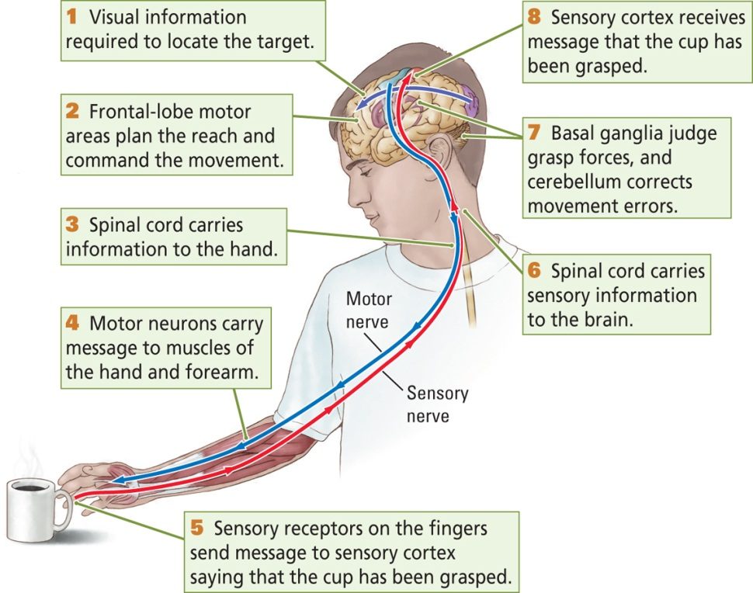
Heirarchical Control of Movement
Movement starts with a goal
This goal is operationalized into a pattern of movements for achieving the goal
This pattern of coordinated movements is converted into activation of the relevant muscles
Sensory information provides feedback about the movement
Errors have to be detected and corrected

Slide 19
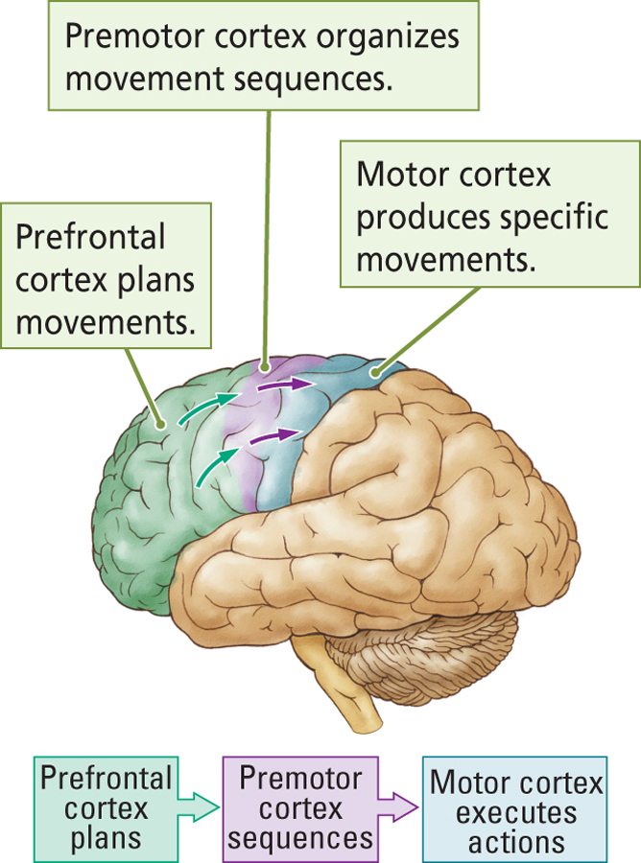
Main Structures Involved in Neural Control of Movement
Prefrontal cortex—initiates movement goals, plans, ideas
Premotor cortex—creates specific movement pattern or sequence
Motor cortex and spinal cord—send movement information out to muscles & other brain regions
Muscles—carry out movements
Basal Ganglia and cerebellum—detects and corrects errors in movement

Slide 20
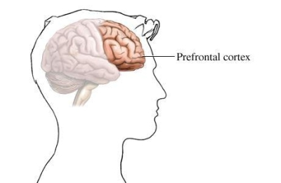
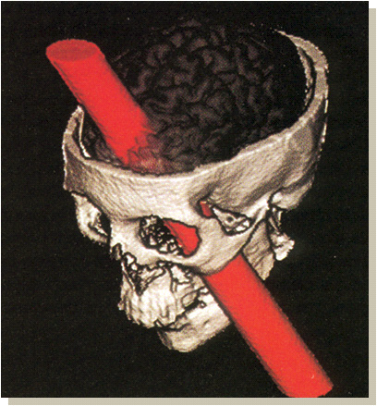
The Prefrontal Cortex
Creates goals from external (lateral PFC) or internal (medial PFC) signals
The PFC then creates a plan for achieving this goal and decides if this plan of action is appropriate—impulse control
What do you think a lesion or damage to the prefrontal cortex might result in?
Lesions to the prefrontal cortex often result in impulsive or inappropriate hehaviors
Does not specify the precise pattern of movements to be made—that is left to the premotor cortex
Neurons in the prefrontal cortex send their axons to the premotor cortex

Slide 21
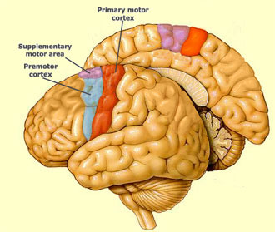
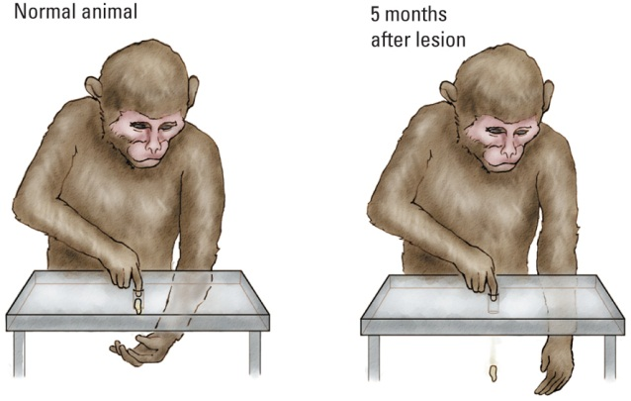
The Premotor Cortex
Produces complex movement patterns or sequences necessary to accomplish the task
What do you think lesions to the premotor cortex might result in?
The premotor cortex also contains mirror neurons, which are activated when a person does an activity and when they SEE the same action being done—may allow imitation and empathy
Neurons in the premotor cortex send their axons to the motor cortex

Slide 22
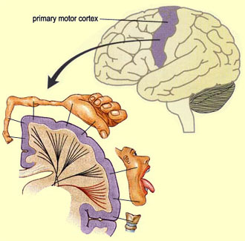
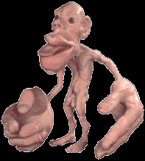
Motor Cortex
The neurons of the motor cortex are arranged in groups that produce movement of key body parts
Motor homunculus—a representation of the motor cortex map, greater size of hands, lips & tongue reflect greater motor innervation of these parts due to their finer movement abilities
The size and complexity of different regions is determined by experience—musicians, athletes have larger representations for body parts involved with their talent
What do you think lesions to the motor cortex result in?
Motor cortex neurons send their axons down through the brainstem as well as to the basal ganglia and the cerebellum

Slide 23
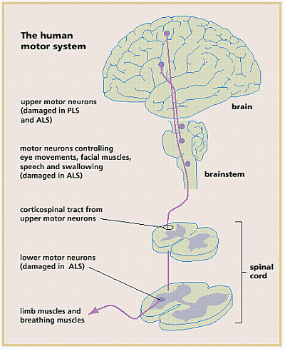
Spinal Cord
Axons from upper motor neurons from motor cortex continue to descend to the spinal cord
Upper motor neurons synapse onto lower motor neurons
Axons of lower motor neurons exit spinal cord via the peripheral nerve and synapse on muscle fibers
The spinal cord also contains central pattern generators—circuits of interneurons that alternatingly activate lower motor neurons down the limbs on both sides of the body to produce rhythmic, cyclic movements like walking
Input from upper motor neurons can activate, inhibit, or modify activity of CPGs

Slide 24
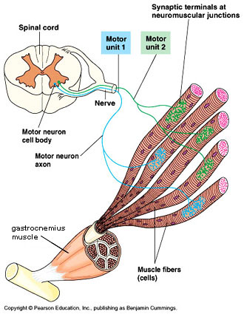
Skeletal Muscle
Consists of long, cylindrical cells called muscle fibers that produce movement by contracting or shortening and pulling against bones
Each muscle fiber gets innervated by a single motor neuron
However a single motor neuron can innervate multiple muscle fibers—motor unit
Agonists are muscles that contract to produce movement, antagonists are muscles that oppose the contracting muscle by passively lengthening

Slide 25
Feedback and Motor Behavior
The basal ganglia, the cerebellum, and sensorimotor input

Slide 26
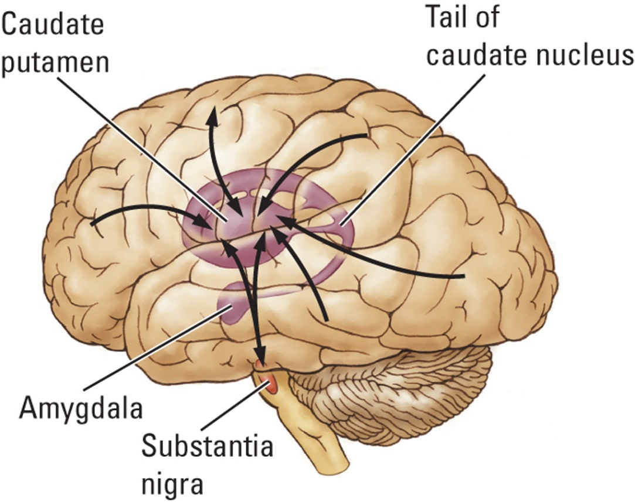
Basal Ganglia
Group of nuclei in the forebrain
Basal ganglia neurons receive input from the motor cortex and the substantia nigra on motor behavior and from the sensory cortex on the success of motor behaviors
Basal ganglia neurons send axons back to the motor cortex via the thalamus
Sensory Cortex
Motor Cortex
+
Substantia
Nigra
Basal Ganglia
Thalamus

Slide 27
Damage to the Basal Ganglia
Hyperkinetic symptoms and the direct pathway—involuntary and/or excessively forceful movements caused by damage to the indirect pathway—Huntington’s chorea, Tourette’s Syndrome tics, obsessive behaviors in OCD, the mania of schizophrenia
Hypokinetic symptoms and the indirect pathway—rigidity & decreased movement production caused by damage to the direct pathway—Parkinson’s Disease
Basal ganglia regulates the likelihood and forcefulness of movements by modulating the drive or motivation the frontal cortex receives
Sensory Cortex
Frontal Cortex
+
Substantia
Nigra
Basal Ganglia
Direct
Indirect
+
-
Thalamus

Slide 28
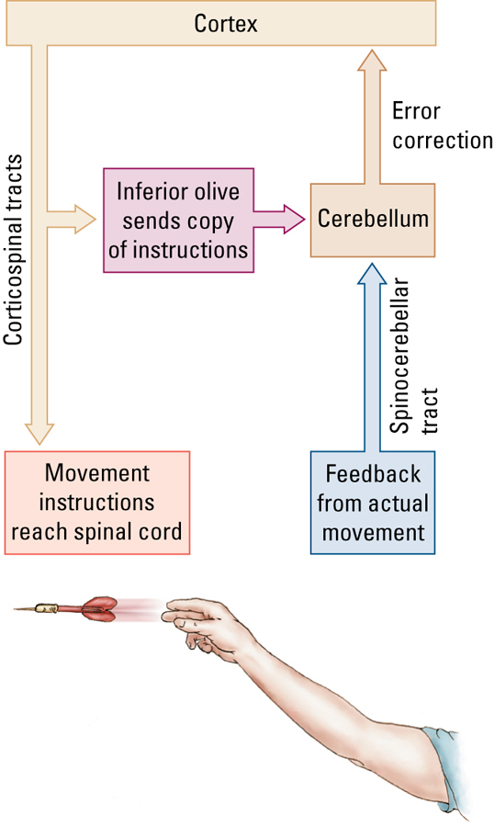
The Cerebellum & Movement Correction
The cortex sends movement information down spinal cord to muscles
The cerebellum also receives a copy of this motor program from the cortex via the inferior olive
Cerebellum compares the motor program with sensory feedback about the movement
Cerebellum then sends corrective feedback to the premotor cortical neurons so that the next time the motor program is sent down it is adjusted based on this sensory feedback and experience
What do you think happens to the dart throwing ability of people with cerebellar damage?

Slide 29
The Somatosensory System

Slide 30
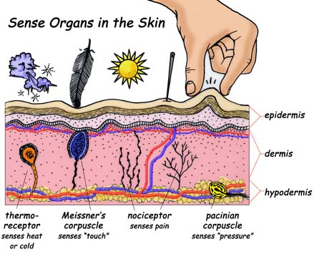
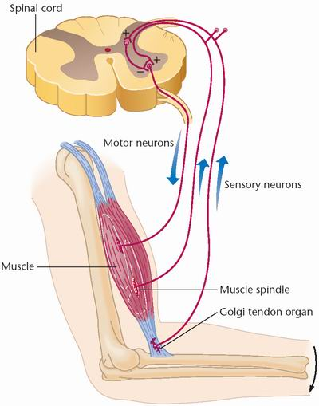
4 Types of Somatosensory Receptors
Thermoreception—(skin) 2 hot and 1 cold
Nociception—(skin and organs) pain—temperature, chemical, mechanical
Hapsis—(skin) itch, light touch, deep pressure, vibration, stretch, texture
Proprioception—(muscles, tendons, and joints) body awareness, muscle stretch and joint angle

Slide 31
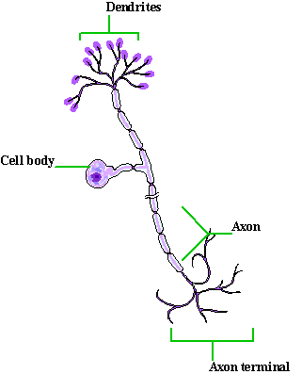
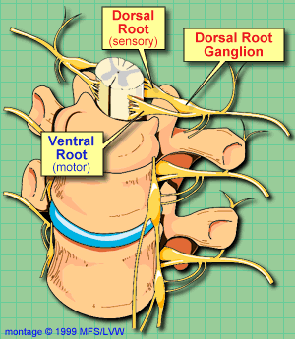
Somatosensory Neurons
Unipolar neurons with one long dendrite that connects directly to the axon
Connect to the spinal cord via spinal nerves
Dorsal root ganglion—contains cell bodies of sensory neurons

Slide 32
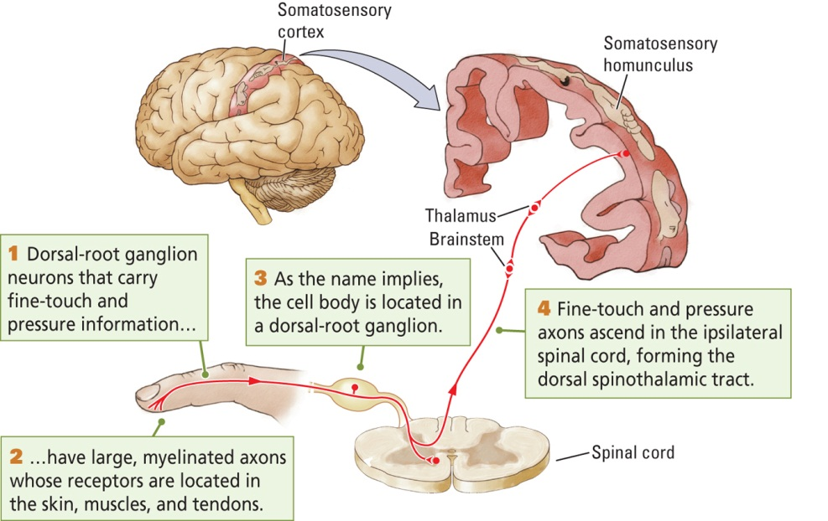
Somatosensory Cortex
Sensory information enters spinal cord and travels to the brainstem and thalamus
Thalamus sends information to the somatosensory cortex
The somatosensory cortex is arranged topographically in a homunculus similar to the motor cortex
Amputees often have phantom feelings in their missing limb because other parts of the somatosensory cortex take over the neurons representing the missing limb

Slide 33
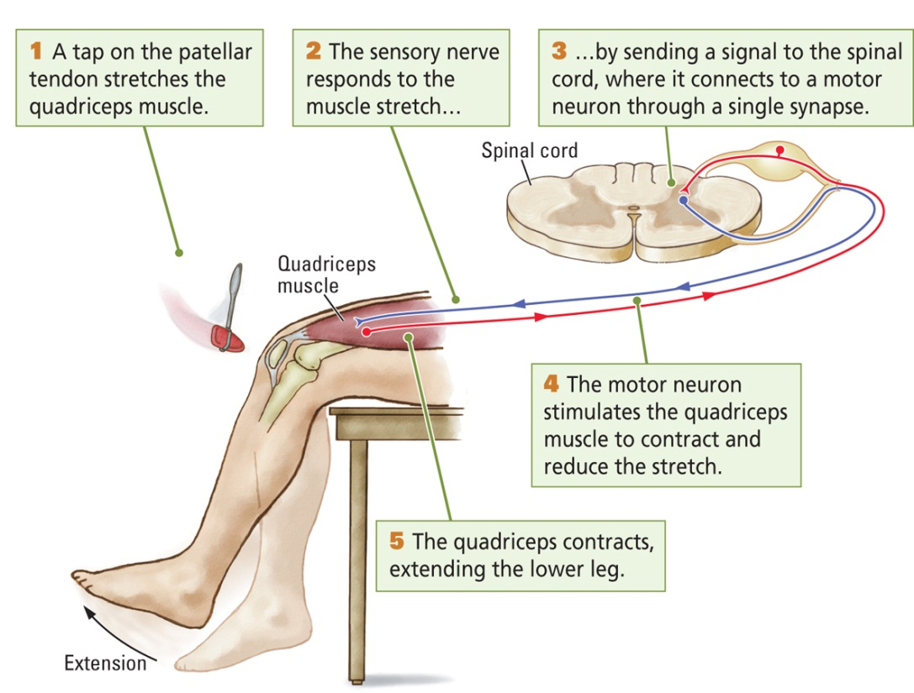
Sensory Reflexes
Sensory information entering the spinal cord synapses on lower motor neurons
Activation of the stretch receptor causes activation of motor neurons, resulting in a twitch
Reflexes allow us to respond much more rapidly than when we process sensory information in the brain
What does testing our reflexes tell us?

Slide 34
Sensory Reflexes
Sensory information entering the spinal cord synapses on lower motor neurons
Activation of the stretch receptor causes activation of motor neurons, resulting in a twitch
Reflexes allow us to respond much more rapidly than when we process sensory information in the brain
Testing of reflexes tells us about how well our sensory and motor neurons are working but tell us nothing about the brain

